Slide 1

POSITION OF FACULTY SCIENCE ON ACADEMIC PROGRAMMES VIABILITY, ACCOMODATION, CLASS ROOM, ACCREDITATION, EXAMINATION, RESULT PROCESSING, CHALLENGES AND WAY FORWARD TO PROPEL EKSU TO WORLD CLASS UNIVERSITY
PROF. L. K. OLOFINTOYE
DEAN, FACULTY OF SCIENCE

Slide 2
INTRODUCTION
The Faculty of Science started with the university at the inception in 1982 with few Departments, but today the Faculty has been expanded and comprises of nine (9) solid Departments are as follows:
  Department of Biochemistry
  Department of Chemistry
  Department of Geology
  Department of Mathematical Sciences
  Department of Microbiology
  Department of Physics
  Department of Plant Science
  Department of Science Laboratory Technology
  Department of Zoology

Slide 3
Table 1: Shows the Departments, Name of Programmes, and Students’ Population
S/N | DEPARTMENT | NAME OF PROGRAMME | STUDENTS’ POPULATION
1 | BIOCHEMISTRY | B. Sc BIOCHEMISTRY | 715
2 | CHEMISTRY | B. Sc CHEMISTRY | 450
3 | GEOLOGY | B. Sc GEOLOGY | 347
4 | MATHEMATICAL SCIENCES | B. Sc MATHEMATICAL SCIENCES | 1,300
5 | MICROBIOLOGY | B. Sc MICROBIOLOGY | 495
6 | PHYSICS | B. Sc PHYSICS | 102
7 | PLANT SCIENCE | B. Sc PLANT SCIENCE | 346
8 | SCIENCE LAB. TECH. | B. Sc SCIENCE LAB. TECH. | 651
9 | ZOOLOGY | B. Sc ZOOLOGY | 190
 | TOTAL |  | 4,596

Slide 4
Fig. 1: Shows the Departments and Students’ Population in the Faculty of Science

Slide 5
Table 2: Shows the Number of Academic Staff in the Faculty of Science
S/N | DEPARTMENT | PROFESSORIAL RANK | SENIOR LECTURER | OTHERS | TOTAL
1 | BIOCHEMISTRY | 6 | Nil | 8 | 14
2 | CHEMISTRY | 7 | 3 | 9 | 19
3 | GEOLOGY | 3 | 2 | 13 | 18
4 | MATHEMATICAL SCIENCES | 4 | 2 | 18 | 24
5 | MICROBIOLOGY | 7 | 1 | 5 | 13
6 | PHYSICS | 2 | 3 | 6 | 11
7 | PLANT SCIENCE | 3 | 2 | 6 | 11
8 | SCIENCE LAB. TECH. | Nil | Nil | Nil | Nil
9 | ZOOLOGY | 3 | 5 | 5 | 13
 | TOTAL | 35 | 18 | 70 | 123

Slide 6
Fig. 2: Shows the Number of Academic Staff in the Faculty of Science
PROFESSORIAL RANK

Slide 7
Table 3: Shows the Number of Technical Staff in the Faculty of Science
S/N | DEPARTMENT | TECHNOLOGIST | OTHERS | TOTAL
1 | BIOCHEMISTRY | 4 | 1 | 5
2 | CHEMISTRY | 2 | 3 | 5
3 | GEOLOGY | 4 | 1 | 5
4 | MATHEMATICAL SCIENCES | Nil | Nil | Nil
5 | MICROBIOLOGY | 5 | 3 | 8
6 | PHYSICS | 4 | 3 | 7
7 | PLANT SCIENCE | 2 | 3 | 5
8 | SCIENCE LAB. TECH. | 5 | 4 | 9
9 | ZOOLOGY | 3 | 2 | 5
 | TOTAL | 29 | 20 | 49

Slide 8
Fig. 3: Shows the Number of Technical Staff in the Faculty of Science

Slide 9
Table 4: Shows the number of Administrative Staff in the Faculty of Science
S/N | DEPARTMENT | SENIOR | JUINOR | DATA ENTRY CLERK | TOTAL
1 | BIOCHEMISTRY | 2 | 1 | Nil | 3
2 | CHEMISTRY | 2 | 1 | Nil | 3
3 | GEOLOGY | 1 | 1 | Nil | 2
4 | MATHEMATICAL SCIENCES | 3 | 1 | 1 | 5
5 | MICROBIOLOGY | 2 | Nil | Nil | 2
6 | PHYSICS | 1 | 1 | Nil | 2
7 | PLANT SCIENCE | 2 | Nil | Nil | 2
8 | SCIENCE LAB. TECH. | 4 | 4 | 1 | 9
9 | ZOOLOGY | 1 | 1 | Nil | 2
 | TOTAL | 18 | 10 | 2 | 30

Slide 10
Fig. 4: Shows the number of Administrative Staff in the Faculty of Science

Slide 11
Table 5: Shows the Accreditation Status of Courses in the Faculty of Science
S/N | DEPARTMENT | ACCREDITATION STATUS
1 | BIOCHEMISTRY | FULL
2 | CHEMISTRY | FULL
3 | GEOLOGY | FULL
4 | MATHEMATICAL SCIENCES | FULL
5 | MICROBIOLOGY | FULL
6 | PHYSICS | FULL
7 | PLANT SCIENCE | FULL
8 | SCIENCE LAB. TECH. | NOT YET ACCREDITED (ONLY RESOURCE ASSESSMENT)
9 | ZOOLOGY | FULL

Slide 12
STATE OF UTILITIES
Water from mains -inadequate.
Power from mains -not
regularly/only on special occasions.
Power from other sources -Faculty Generator
4hrs daily (Mon-Thurs)
Staff Toilets -functional but not
adequate
Student Toilets - available/not adequate
Environment -needs improvement
Parking Facilities -inadequate

Slide 13
TEACHING UTILITIES
Number of lecture rooms (shared) -10
Seating capacity -ranged from 36 to 72
Number of lecture rooms (solely owned) -nil
Seating capacity -N/A
Number of lecture theatres -4
Seating capacity -750 to 1050

Slide 14
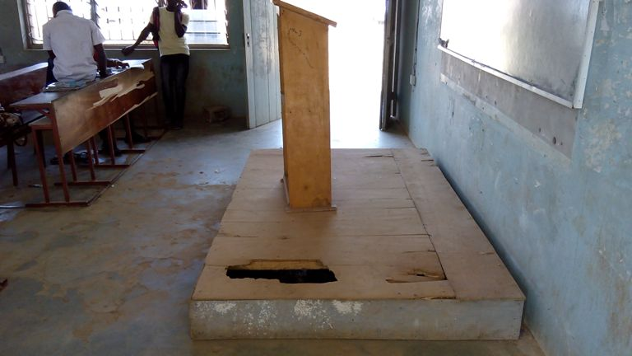
Plate 7: Shows the Damaged Podium in a lecture room with broken floor

Slide 15
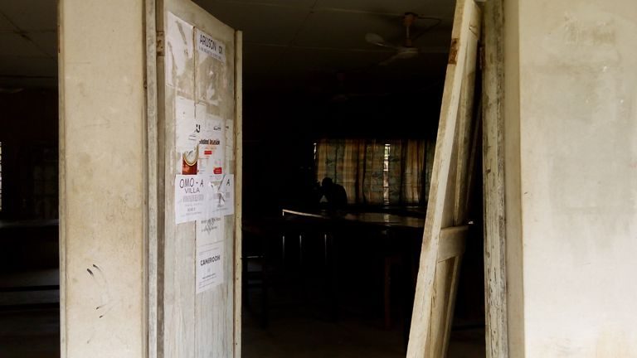
Plate 8: Shows the Sample of Lecture rooms with spoilt doors

Slide 16
DEFICIENCES
State of Infrastructure
Structural deficiency -little
Furniture -not adequate
Lighting -not adequate
Ventilation -adequate
Cleanliness -averagely okay
No. of rooms with whiteboards -10
No. of rooms with smartboards -nil
No. of rooms without boards -4 cracked boards
Power point facilities -not adequate
Public address system -not available

Slide 17
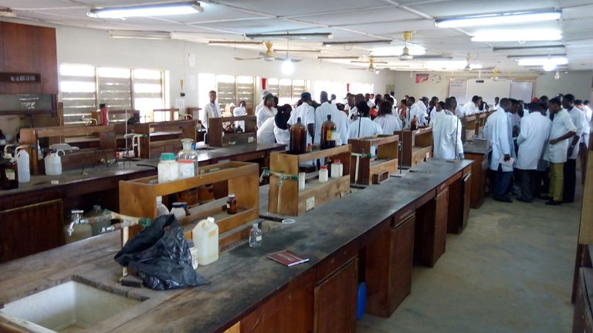
Plate 4: Shows an overcrowded Lab. with Students struggling to use Lab. materials that are not sufficient

Slide 18
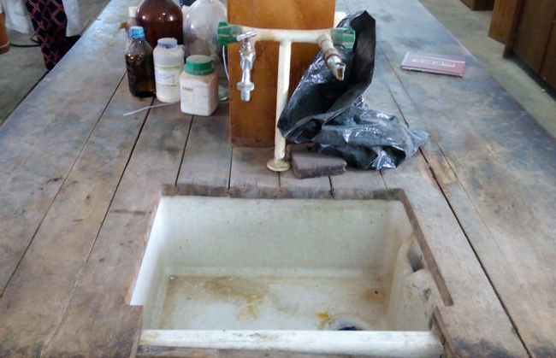
Plate 5: Shows the Sample of broken Taps and Sinks in the laboratory

Slide 19
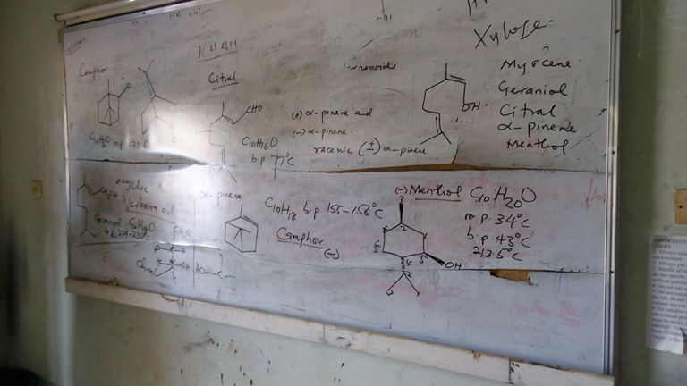
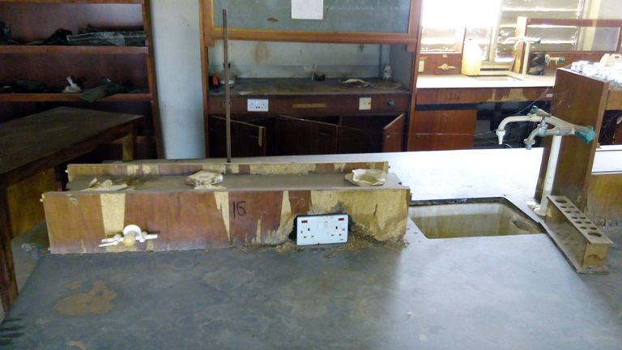
Plates 6A and 6B : Show the dilapidated Lab.Cupboard (6A) and whiteboard(6B)

Slide 20
LABORATORY FACILITIES
Space -inadequate
Equipment - inadequate
Power - inadequate
Water - inadequate
Fire extinguishers - inadequate
Deficiencies
space not enough
Scanty number of equipment
No regular supply of electricity
Extinguishers supplied not enough

Slide 21
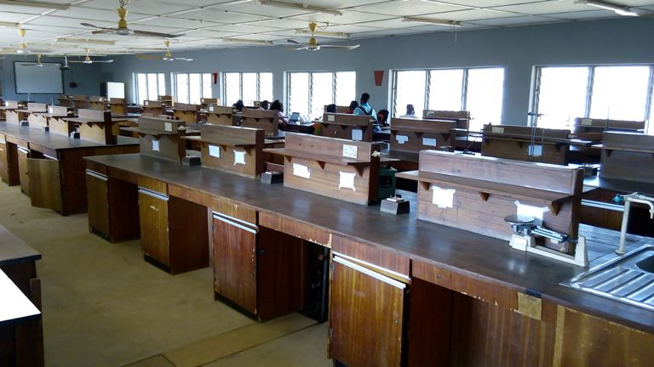
Plate 1: Shows the Laboratory that can only accommodate 60 Students when it was built in 1985

Slide 22
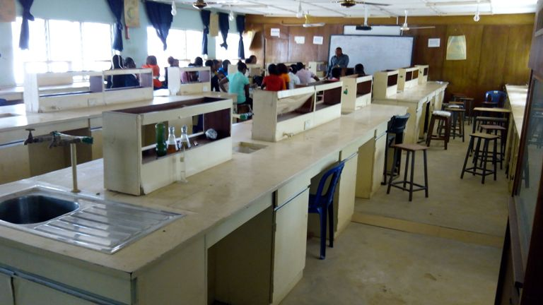
Plate 2: Shows the Laboratory that can only accommodate 60 Students when it was built in 1985

Slide 23
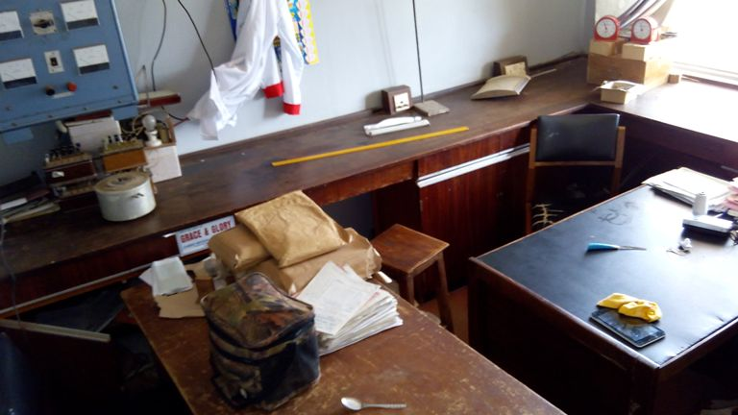
Plate 3: Shows a Staff Office in the Lab that is congested and out-dated

Slide 24
FACULTY/DEPARTMENTAL LIBRARY FACILITIES
Space -inadequate
Textbooks - inadequate
Journals - inadequate
Internet facilities - inadequate
RECREATIONAL FACILITIES
Staff common room -not available

Slide 25
STUDENTS’ EXAMINATION RESULTS
Average number of days between the examination and submission of score sheets -15 days
Average number of days for compilation of results -15days
Compilation modalities -manual
Challenges -results of general courses not readily available within scheduled time.
Storage mode and retrieval of results -kept in files and cabinets and manual searching.
Mode of students’ access to results -notice boards/level advisers/course lecturers.

Slide 26
NEW PROGRAMMES IN VIEW
Mathematics (B. Sc Mathematics)
Statistics (B. Sc Statistics)
Computer Science (B. Sc Computer Science)
Chemistry (B. Sc Chemistry)
Industrial Chemistry (B. Sc Industrial Chemistry)
. Diploma Courses in some Programmes
Justification
Qualified Academic Staff
Adequate number of students

Slide 27
Table 6: Shows Postgraduate programmes and number of students in the Faculty of Science
Number of Students
S/N | DEPARTMENT | PGD | MASTERS | PhD | TOTAL
1 | BIOCHEMISTRY | - | 23 | 4 | 27
2 | CHEMISTRY | - | 10 | 4 | 14
3 | GEOLOGY | - | 3 | - | 3
4 | MATHEMATICAL SCIENCES | 4 | 44 | 10 | 58
5 | MICROBIOLOGY | 5 | 25 | 15 | 45
6 | PHYSICS | - | 6 | 5 | 11
7 | PLANT SCIENCE | 2 | 6 | 6 | 14
8 | SCIENCE LAB. TECH. | - | - | - | Nil
9 | ZOOLOGY | - | 4 | 4 | 8
 | TOTAL | 11 | 121 | 48 | 180

Slide 28
Fig. 6: Shows Postgraduate programmes and number of students in the Faculty of Science

Slide 29
AVERAGE PERIOD FOR GRADUATION
PGD 2 semesters
Masters 4 semesters
Ph. D 6 semesters
PROFESSIONAL PROGRAMME
Programme -Science Laboratory Technology
Number of students -651
Average Period for
graduation 10 semesters
Reasons for delay -Nil
RESEARCH FACILITIES
Laboratory space -inadequate
Equipment -inadequate
Books/Journals -inadequate

Slide 30
FREQUENCY OF DEPARTMENTAL SEMINARS - MONTHLY
Major challenges:
  Inadequate Academic Staff
  Laboratory space not adequate
  Inadequate infrastructures
  Non-availability of ICT-enabling environment
  Inadequate electricity supply
  Inadequate water supply
  Equipment not adequate
  Zoological garden not available

Slide 31
FIELD TRIP
Field trip is a compulsory exercise for final year students in some departments in the Faculty of Science.
The field trip is also a main course which must be passed before graduation. It requires some basic things to be on ground for the successful completion of the exercise.
These are:
  Provision of buses to convey students to the various sites of the field trip.
  Provision of DTA for staff.

Slide 32
ALLOCATION OF HALLS FOR EXAMINATIONS
The way and manner Halls/Lecture theatres are been allocated for examinations calls for proper re-organisation.
The stereotype format used every semester must change to consider the number of students offering each course vis-vis the type and size of halls to be allocated.
This is to prevent occurrence of various types of examination malpractices every semester.

Slide 33
RENOVATION OF LECTURE ROOMS AND LABORATORIES
In addition to the new lecture rooms on ground, the old ones need prompt attention in the areas of renovation to include re-roofing, tiling, provision of chairs and tables, interactive boards and painting.
The laboratories also require renovation and supply of reagents, chemicals and equipment. Practicals are not run adequately as laid down in the student handbook for various courses.

Slide 34
UNIVERSITY CALENDAR
The University Calendar for the past five sessions has been overlapping and destructing normal academic activities, changing the normal University system to an abnormal one.
The effects of this are enormous, ranging from inadequate time to rest by the staff, students not graduating at the right time, newly admitted students resuming a month or less than a month to the first semester examination every session, affecting some academic programmes to be executed in between the end of first semester and the commencement of second semester, such as Field Trip.

Slide 35
EXAMINATION OFFICERS
There is need to properly re-organise and empower examination officers in each department for efficient result computation instead of loading the Heads of Departments with this responsibility.

Slide 36
CONFERENCE SPONSORSHIP
The mode of presenting applications for conference sponsorship (both local and international) has been established but after the approval of the application, there is always no hope for whether the applicant will enjoy the sponsorship due to administrative non-supportive syndrome.
And if the applicant will eventually enjoy the sponsorship, it takes almost a year after the conference. In view of this, there should be a smooth processing and payment of this fund to the applicant.

Slide 37
SCHOLARSHIP
There are various information on academic scholarship, most especially at the postgraduate level available in the information office of the University.
The information do not reach their destinations until a week to the closing date of such applications.
This has hampered the processing of some applications and what we only gain is just to read and drop it, since the processing of the application form will not meet the deadline stipulated.
It is therefore advised that such information be given prompt attention to facilitate smooth and early processing.

Slide 38
ADMISSION PROCESSING
Admissions are not properly done the way it should be, when it comes to the issue of discretional list either from the VC.
The gate keepers use this opportunity to load the admission list in disguise of the VC’s list.
The neater way of doing this is to compile the VC’s list, signed by the VC, to avoid loading of names. There is no H.O.D or Dean that will not recognise the VC’s list.

Slide 39
MARKING EXERCISE
It is disheartening to find out that some academic staff are not bold enough to submit their marked scripts for scrutiny before the NUC accreditation team because of the insanity and fraud they have committed during markings.
To avoid this, all scripts marked must be submitted to the office of the Head of Department as the score sheets are submitted.

Slide 40
Other Academic Frauds and lawlessness
Some cases are pending on plagiarism, falsification of research results, must be re-visited.
Extorting students on project supervision, must be checked.
Sexual harassment must stop.
Low level of accessibility of staff to students.
Using foul languages on students.
Delay in attending to mails.
Lateness to meetings.
Lateness to work and examination hall
Absence from work without permission
Delay in submission of exams scores.
Delay in computation of results.

Slide 41
Thank You.

